Slide 1
The Future of Law: AI-assisted Utopia or Jobless Robot Hellscape?
Michael Simon
Principal and Ronin
508-429-0923
Michael.Simon@SeventhSamurai.com

Slide 2
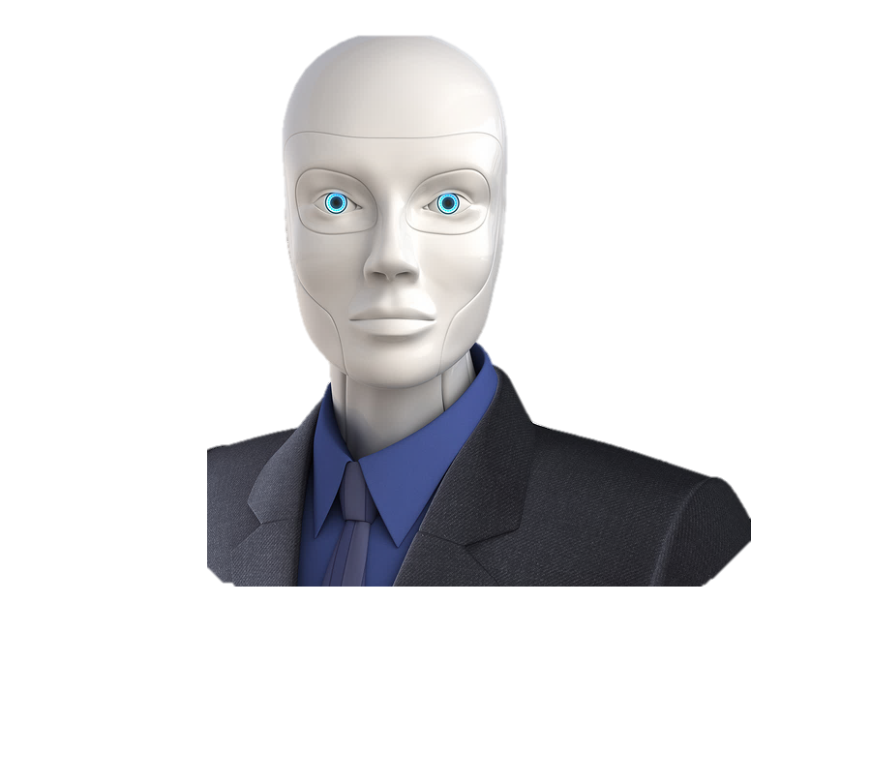
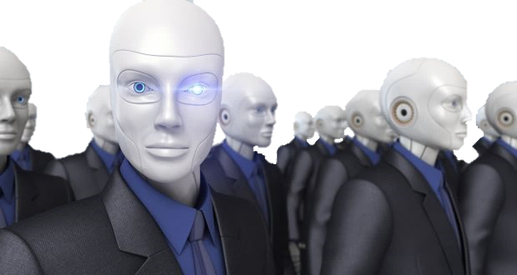

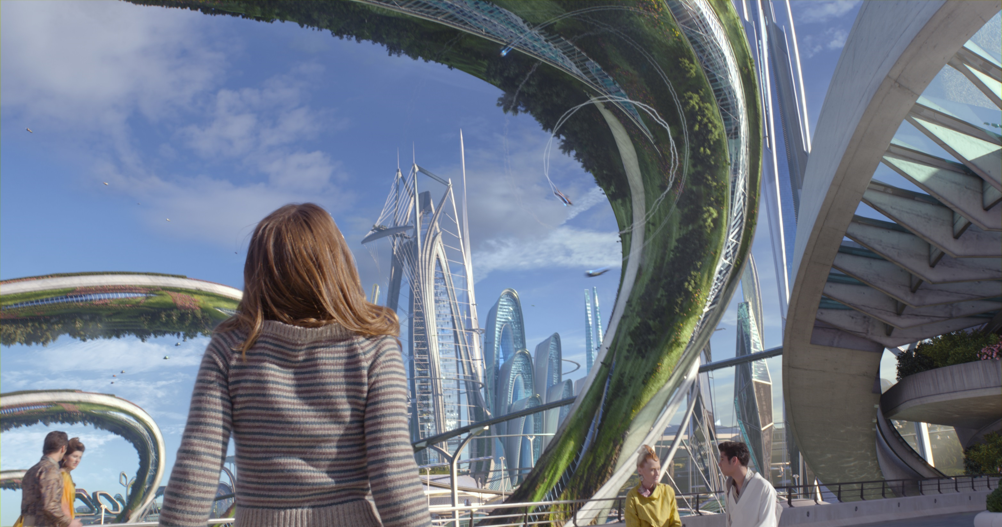

Slide 3
A.I. ≠ F.H.
(“Fake Human”)

Slide 4

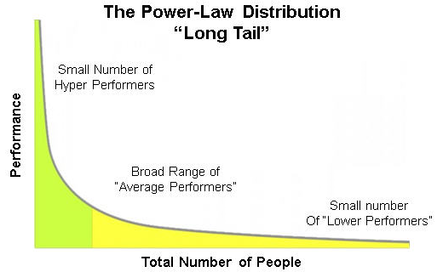

Slide 5
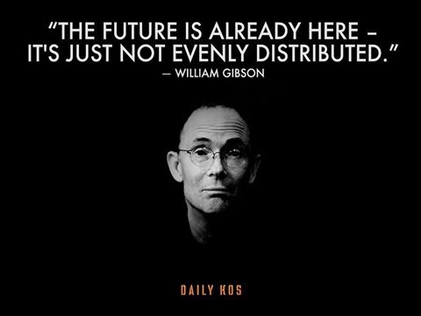
“THE FUTURE IS ALREADY HERE – IT’S JUST NOT EVENLY DISTRIBUTED”
- WILLIAM GIBSON
“. . . AND IT NEVER WILL BE”
- MICHAEL SIMON

Slide 6
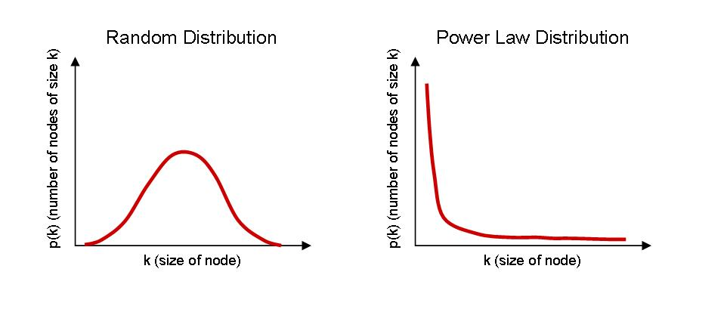
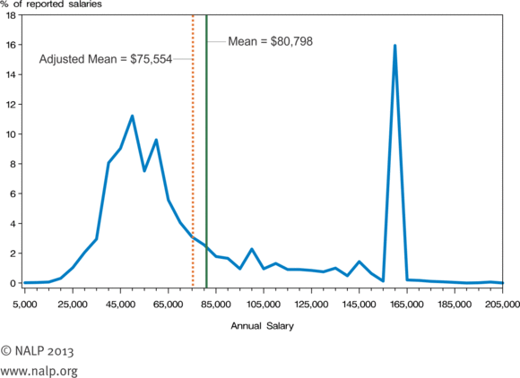

Slide 7
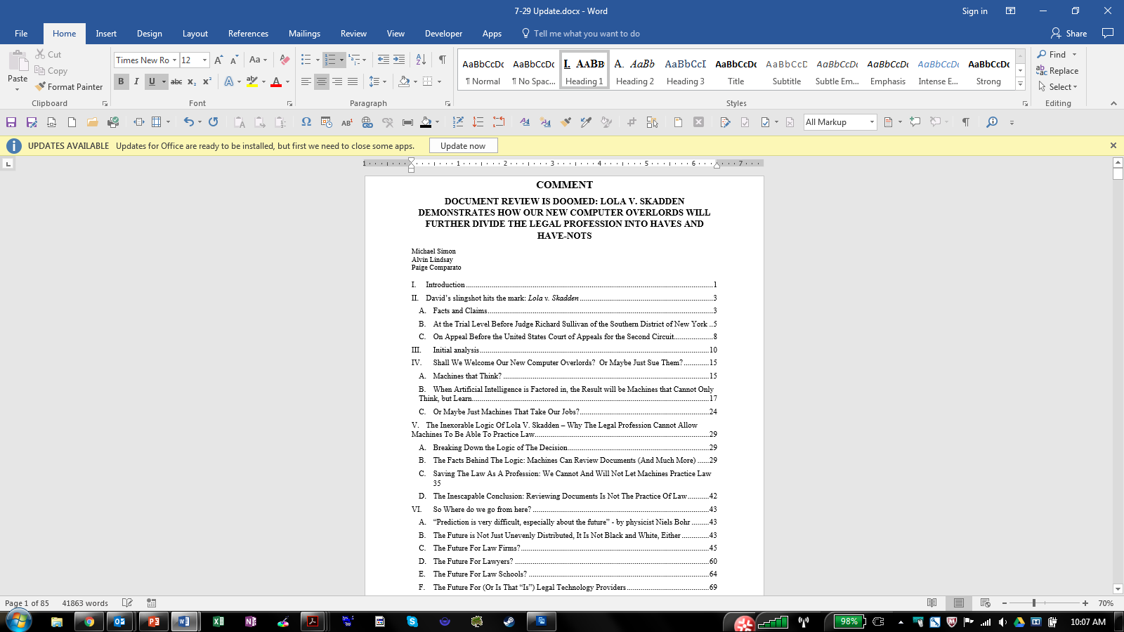
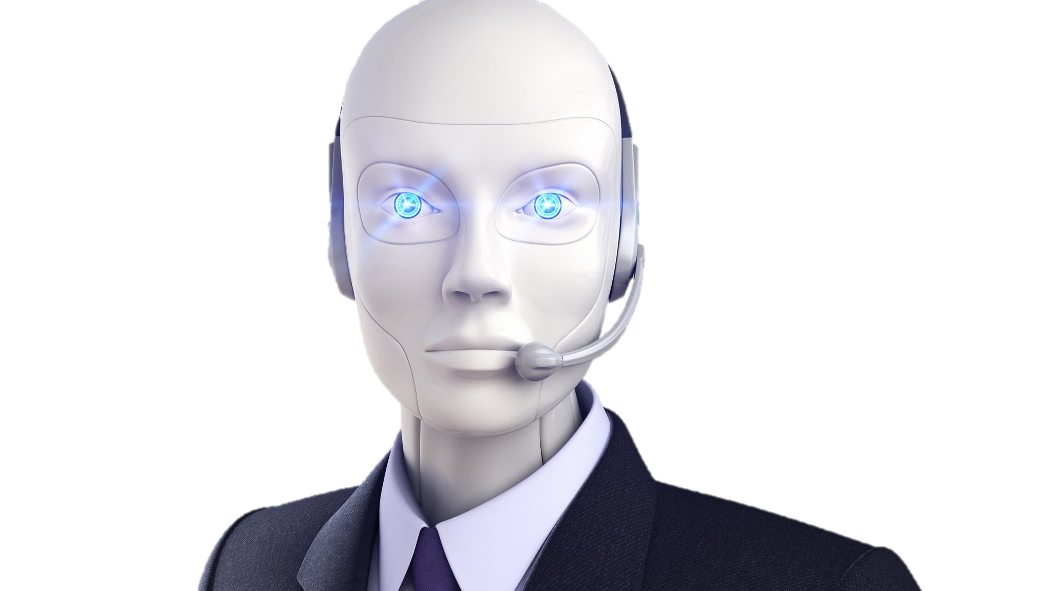

Slide 8

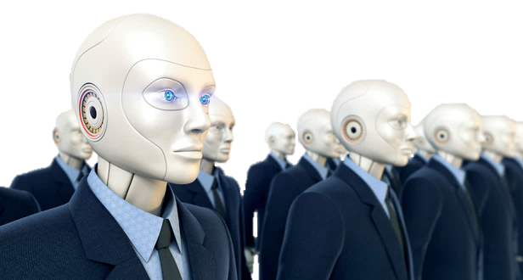
≠ Lawyers

Slide 9
(Original, unedited source: Dan Katz, “Quantitative legal prediction . . .,” Emory Law Journal, Vol. 62, 2013. Dec. 11, 2012)

Slide 10

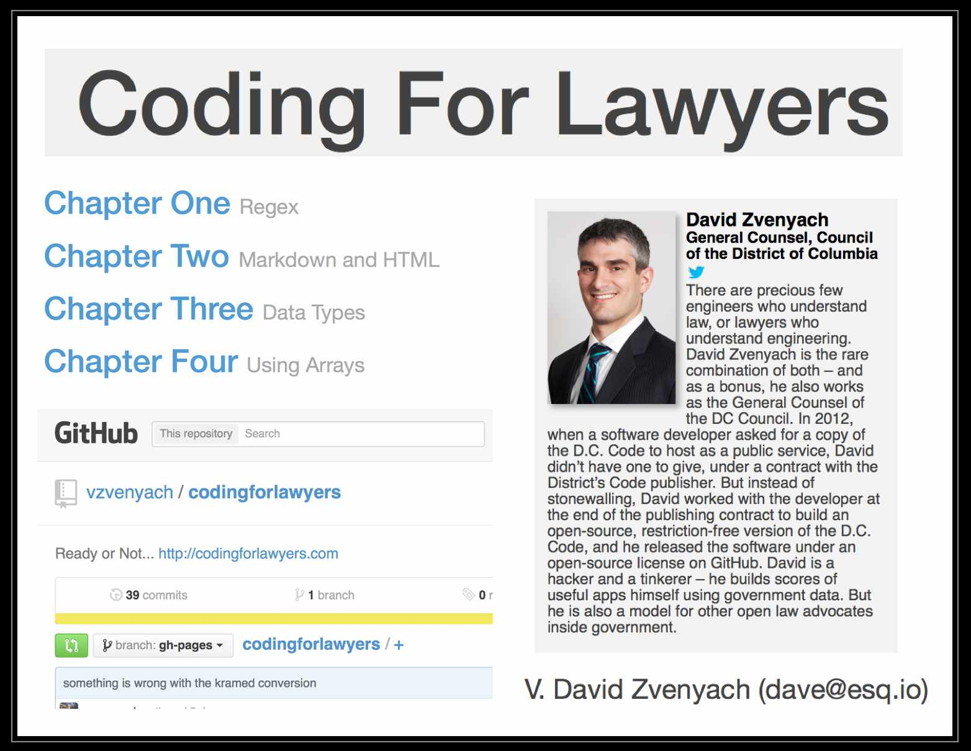

Slide 11
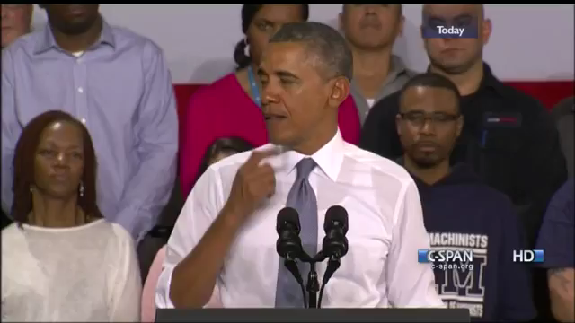

Slide 12
☺
☺
☺
☺
☺
☹
☹
☹
☹
☹
☹
☹
☹
☹
☹
☹
☹
☹
☹
☹
☹
☹
☹
☹
☹
☹
☹
☹
☹
☹
☹
☹
☹
☹
☹
☹
☹
☹
☹
☹
☹
☹
☹
☹
☹
☹
☹
☹
☹
☹
☹
☹
☹
☹
☹
☹
☹
☹
☹
☹
☹
☹
☹
☹
☹
☹
☹
☹
☹
☹
















15 Law + Unemployed

Slide 13


Slide 14


Slide 15
Thank You
If you want a copy of the law journal article, please give me your card or contact me
Michael Simon
Principal and Ronin
508-429-0923
Michael.Simon@SeventhSamurai.com

